Slide 1

Website-Control-Light-System-Using-IOT
Team members:
1- Ahmed Ibrahim Tawfik (Team leader) 2- Ola Mohamed 3- Ahmed Ragab 4- Marawan Atef

Slide 2
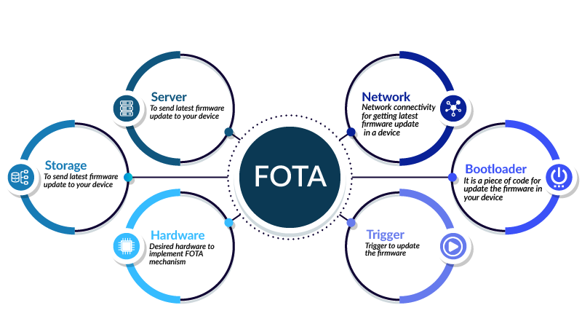

Slide 3

Main IDEA:
➡ 𝐒𝐨𝐟𝐭𝐰𝐚𝐫𝐞 𝐀𝐫𝐜𝐡𝐢𝐭𝐞𝐜𝐭𝐮𝐫𝐞: 𝐋𝐚𝐲𝐞𝐫𝐞𝐝 𝐀𝐩𝐩𝐫𝐨𝐚𝐜𝐡 ⬅ 1- 𝐀𝐩𝐩𝐥𝐢𝐜𝐚𝐭𝐢𝐨𝐧 𝐋𝐚𝐲𝐞𝐫: - The application layer will handle user interactions and communicate with the ESP8266 module and STM32F401CC to control the lights over the air. 2- 𝐇𝐀𝐋 (𝐇𝐚𝐫𝐝𝐰𝐚𝐫𝐞 𝐀𝐛𝐬𝐭𝐫𝐚𝐜𝐭𝐢𝐨𝐧 𝐋𝐚𝐲𝐞𝐫): - Here, we'll interface with the hardware components, including LEDs and the ESP8266 module. This layer abstracts the hardware details, making it easier to develop and maintain. 3- 𝐌𝐂𝐀𝐋 (𝐌𝐢𝐜𝐫𝐨𝐜𝐨𝐧𝐭𝐫𝐨𝐥𝐥𝐞𝐫 𝐀𝐛𝐬𝐭𝐫𝐚𝐜𝐭𝐢𝐨𝐧 𝐋𝐚𝐲𝐞𝐫): - This layer deals with microcontroller-specific functionalities, like configuring clocks (RCC), managing GPIOs, handling interrupts (NVIC), system tick (Systick), external interrupts (EXTI), and serial communication (USART).

Slide 4
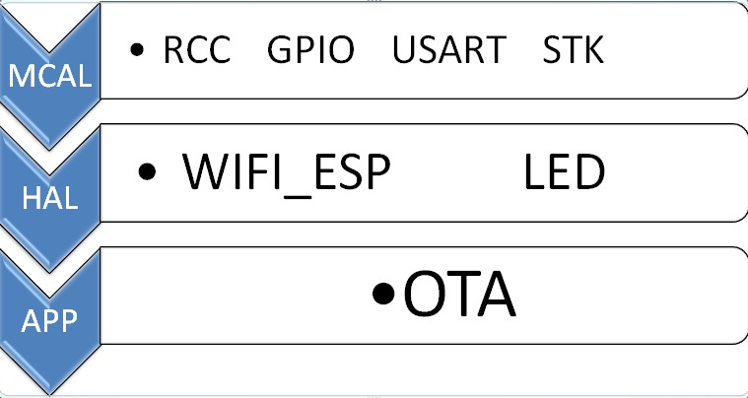

Slide 5
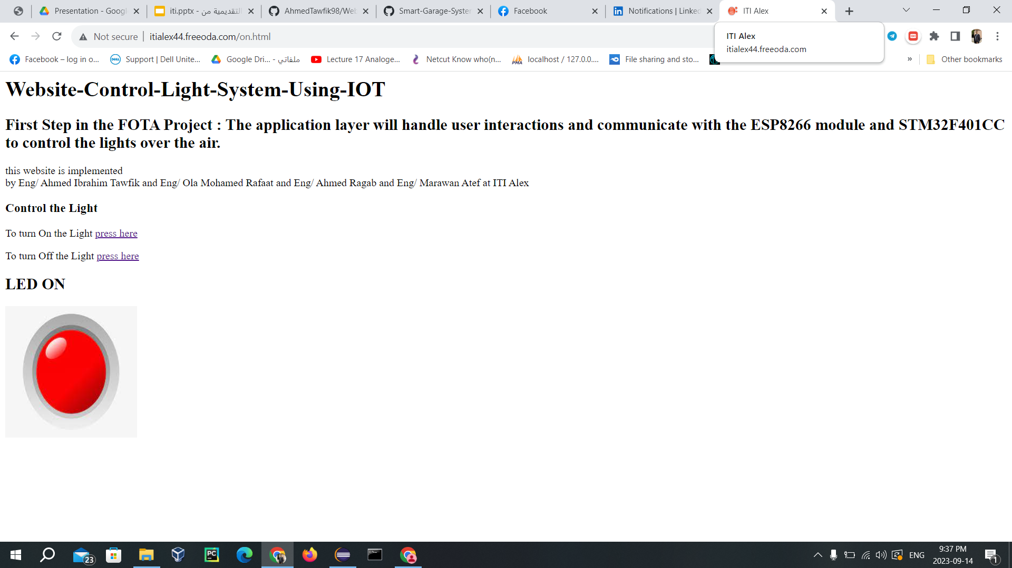
🌐 𝐁𝐮𝐢𝐥𝐝𝐢𝐧𝐠 𝐭𝐡𝐞 𝐖𝐞𝐛𝐬𝐢𝐭𝐞: To make our project accessible and user-friendly, we'll create a web interface. Here's how we'll do it:
1) using Filezilla making website. 2) Writing HTML and PHP code.

